Slide 1
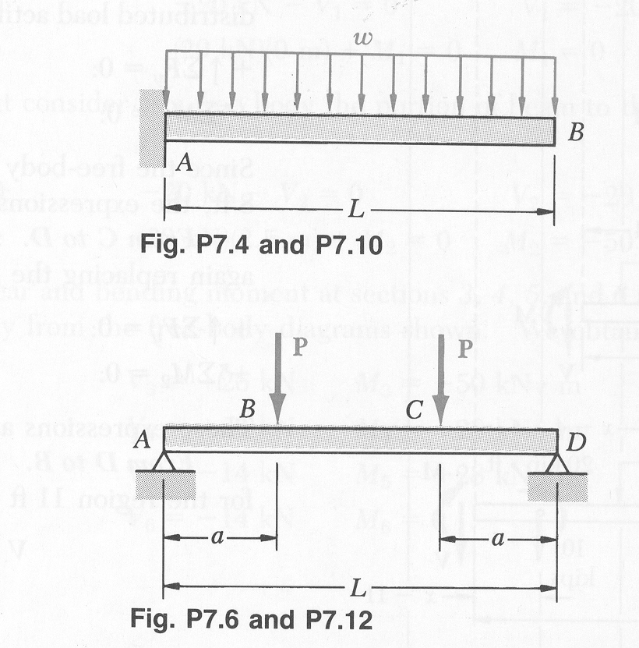
Draw the load, shear, bending moment, curvature, and deflection diagrams for the two beams below by inspection. Be sure to identify all important points and label values that can be easily calculated.

